Slide 1

CoMEt: a statistical approach to identify combinations of mutually exclusive alterations in cancer
Max Leiserson*, Hsin-Ta Wu*, Fabio Vandin, Benjamin Raphael
Genome Biology 16, 160 (2015) doi:10.1186/s13059-015-0700-7
* Equal contribution
February 2nd, 2016

Slide 2
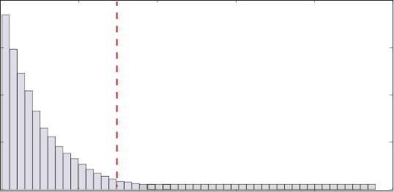
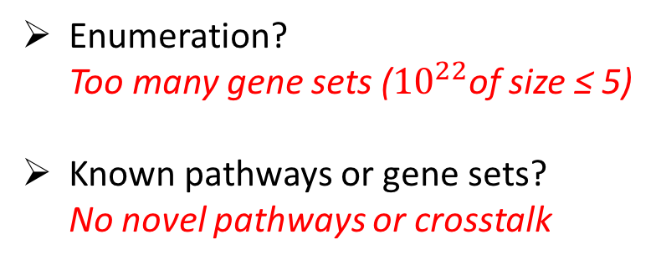
Driver mutations target pathways
10-35 genes
N=250-500 samples
Significance Score
A
Vogelstein, et al. (Science, 2013)
interacts with
B
“long tail”
A
B
Can we discover the pathways?
Enumeration? Too many gene sets (${10}^{22}$of size ≤ 5)
Known pathways or gene sets? No novel pathways or crosstalk
TCGA
(Nature 2012)
Colorectal study

Slide 3
Driver mutations in pathways are often mutually exclusive
Few driver mutations distributed across multiple pathways
➔Approximately one driver mutation per pathway per patient
Genes/Loci
Patients
[Thomas, et al. 2007]
Dendrix [Vandin, et al. RECOMB 2011]
Muex [Szczurek, et al. RECOMB 2014]
Dendrix++ [TCGA, NEJM 2013]
MEMCover [Kim, et al. ISMB 2015]
Mutex [Babur, et al. Genome Biology 2015]
Others…

Slide 4
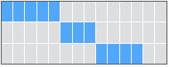
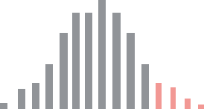
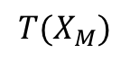
Combinations of mutually exclusive alterations (CoMEt) algorithm
Hsin-Ta Wu
Statistical score that is less biased towards most frequently mutated genes.
MCMC algorithm identifies multiple exclusive modules by examining distribution of solutions
Outperforms prior methods on simulated and real data.
Identifies combinations overlapping cancer pathways in multiple tumor types.
Gene 1
Gene 2
Gene 3
$$T(X_{M})$$
[Leiserson*, Wu*, et al. Genome Biology 2015. Also RECOMB 2015.]

Slide 5
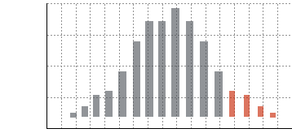
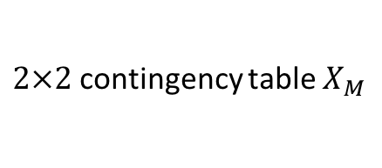
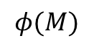
Motivation for statistical score
Most frequently mutated genes can dominate the mutual exclusivity signal.
EGFR(A) (127)
TCGA Glioblastoma (GBM) (Nature, 2008)
TRHDE (8)
MAST2 (6)
PTEN (76)
PTEN(D) (41)
exclusive
co-occurring
IDH1 (14)
(A) = amplification; (D) = deletion
Surprise of mutual exclusivity conditioned on the mutation’s frequency.
Gene 2
$$φ(M)$$
 | Not Mutated | Mutated
Not mutated | 7 | 2
Mutated | 4 | 1
One-sided Fisher’s exact test for independence
Hypergeometric probability
Gene 1
$2×2$contingency table $X_{M}$
Exclusivity

Slide 6
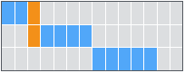

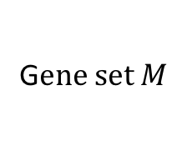
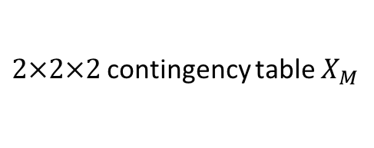
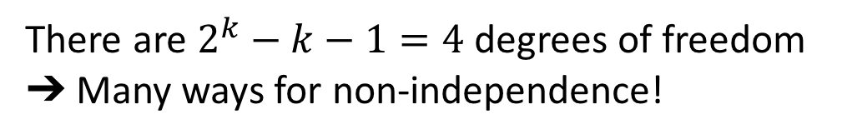
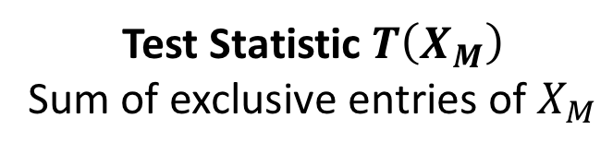
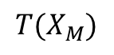
Score a combination of $k=3$ genes
Gene 1
Gene 2
There are $2^{k}−k−1=4$ degrees of freedom
➔ Many ways for non-independence!
Gene 3
G$ene set M$
Gene 2
 | Not Mutated | Mutated
Not mutated | 5 | 0
Mutated | 0 | 0
Test Statistic $T\left(X_{M}\right)$
Sum of exclusive entries of $X_{M}$
mutated
Gene 1
Gene 3
$$φ(M)$$
Gene 2
not mutated
 | Not Mutated | Mutated
Not mutated | 2 | 2
Mutated | 4 | 1
Hypergeometric probability
Gene 1
exclusive
Exclusivity
co-occurring
$2×2×2$contingency table $X_{M}$
$$T(X_{M})$$

Slide 7
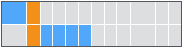
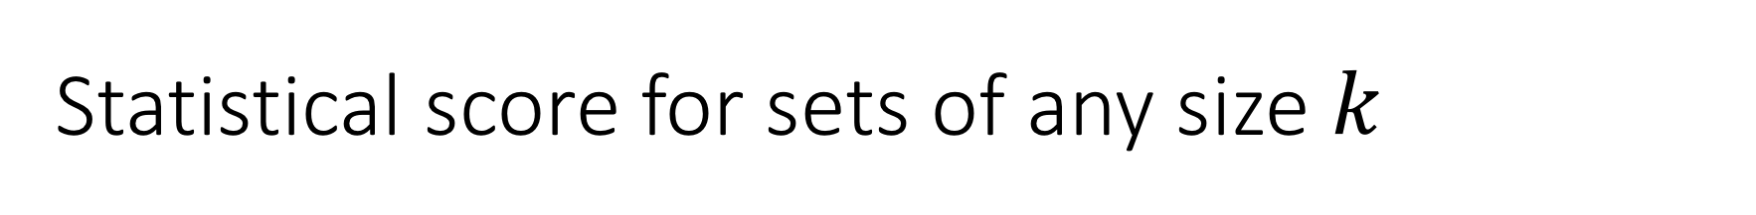
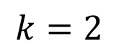
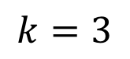
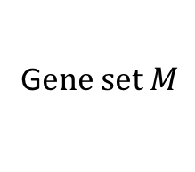
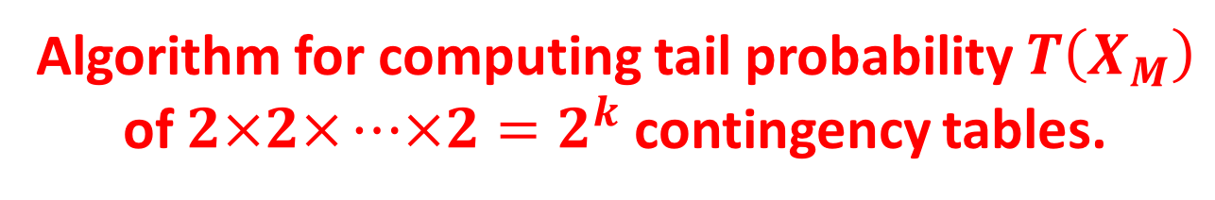
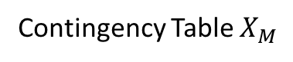
Statistical score for sets of any size $k$
G$ene set M$
Contingency Table $X_{M}$
Gene 1
 | Not Mutated | Mutated
Not mutated | 7 | 2
Mutated | 4 | 1
$$k=2$$
Gene 2
not mutated
mutated
Gene 1
$$k=3$$
Gene 2
 | Not Mutated | Mutated
Not mutated | 2 | 2
Mutated | 4 | 1
 | Not Mutated | Mutated
Not mutated | 5 | 0
Mutated | 0 | 0
Gene 3
…
…
…
Algorithm for computing tail probability $T\left(X_{M}\right)$ of $2×2×⋯×2=2^{k}$ contingency tables.

Slide 8
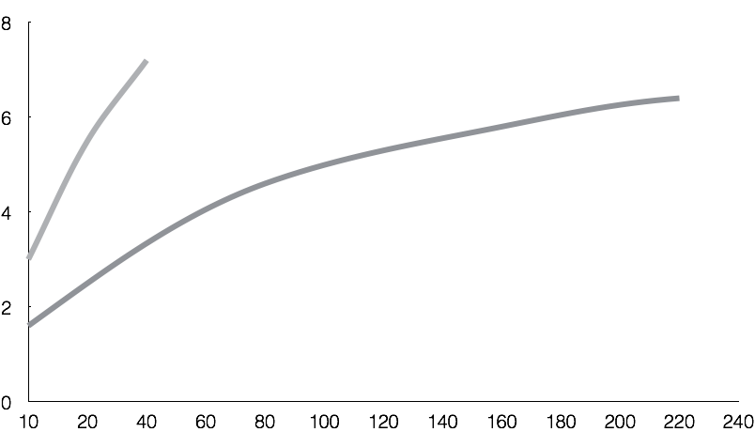
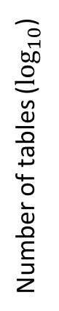
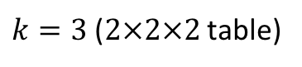
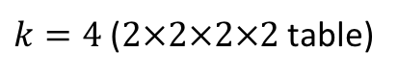
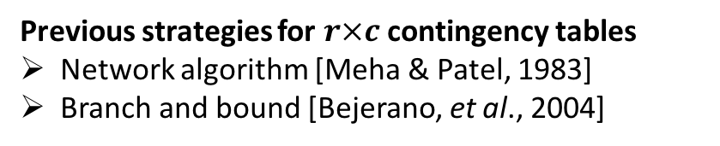
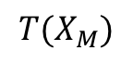
Computing exact test can be expensive
$k=4$ ($2×2×2×2$ table)
$$T(X_{M})$$
$k=3$ ($2×2×2$ table)
Hypergeometric prob.
Number of tables (${\text{log}}_{10}$)
Exclusivity
[Zelterman, et al. 1995]
more exclusive
less exclusive
Sample size
Compute tail probability by enumerating contingency tables with fixed margins.
Previous strategies for $r×c$ contingency tables
Network algorithm [Meha & Patel, 1983]
Branch and bound [Bejerano, et al., 2004]
Only enumerate the more exclusive tables.

Slide 9
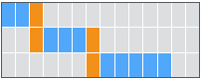
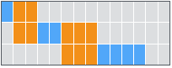
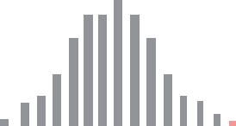
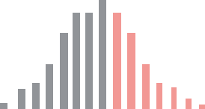
Only enumerate “more exclusive” tables
Perfectly exclusive
Approximately exclusive
Less exclusive
Gene 1
Gene 1
Gene 1
Gene 2
Gene 2
Gene 2
Gene 3
Gene 3
Gene 3
exclusive
co-occurring
more exclusive
less exclusive
$$T(X_{M})$$
$$T(X_{M})$$
Hypergeometric prob.
$$T(X_{M})$$
Hypergeometric prob.
Hypergeometric prob.
Sum of exclusive cells
Sum of exclusive cells
Sum of exclusive cells
Binomial/Permutational approximation.
No tables to enumerate!
Enumerate more exclusive tables.

Slide 10
Combinations of mutually exclusive alterations (CoMEt) algorithm
Hsin-Ta Wu
Statistical score that is less biased towards most frequently mutated genes.
MCMC algorithm identifies multiple exclusive modules by examining distribution of solutions
Outperforms prior methods on simulated and real data.
Identifies combinations overlapping cancer pathways in multiple tumor types.
Gene 1
Gene 2
Gene 3
$$T(X_{M})$$
[Leiserson*, Wu*, et al. Genome Biology 2015. Also RECOMB 2015.]

Slide 11
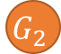
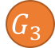
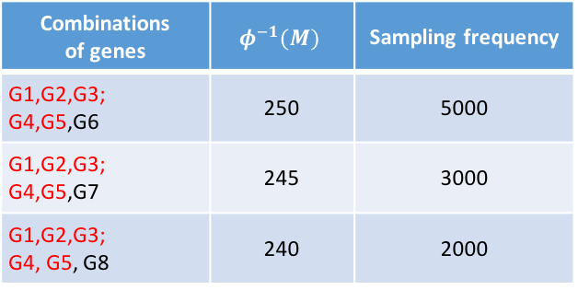
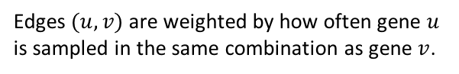
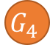





Patients have alterations in multiple pathways
Need to search for multiple sets of alterations simultaneously [Multi-Dendrix; Leiserson, et al. 2013]
But we do not know the number or size of pathways a priori and there are often many suboptimal solutions...
[Vogelstein, et al. 2013]
Compute marginal probability of pairs with exclusive alterations to identify modules
Multiple suboptimal solutions
Marginal probability graph
Combinations of genes | $$φ^{−1}(M)$$ | Sampling frequency
G1,G2,G3; G4,G5,G6 | 250 | 5000
G1,G2,G3; G4,G5,G7 | 245 | 3000
G1,G2,G3; G4, G5, G8 | 240 | 2000
1.0
$$G_{6}$$
$$G_{7}$$
$$G_{1}$$
$$G_{2}$$
$$G_{8}$$
1.0
0.20
Gene legend
1.0
0.50
= CoMEt module
G2
$$G_{3}$$
$$G_{4}$$
$$G_{5}$$
1.0
= other
Edges $(u, v)$ are weighted by how often gene $u$ is sampled in the same combination as gene $v$.
MCMC algorithm samples $t$ sets of size $k$ in proportion to their combined statistical score.

Slide 12
Results
Comparison to Multi-Dendrix, muex, and mutex on simulated data.
Application to TCGA glioblastoma, breast cancer, leukemia, and stomach cancer datasets.
Combinations of mutations in cancer pathways
Overlapping pathways
Subtype-specific mutations

Slide 13
CoMEt results on TCGA Glioblastoma (GBM)
398 mutated genes in 261 tumor samples [TCGA, Nature 2008]
Highest weight sets ($t=4, k=4$) found by CoMEt $(P<0.01)$
Figure 5 [TCGA, Nature 2008]
CDKN2A (D)
CDK4 (A)
Rb signaling
RB1
MSL3
$φ={2.2×10}^{−21}$ Coverage: 89% (232/261 samples)
(A) = amplification
(D) = deletion
exclusive
co-occurring
TP53
MDM2(A)
MDM4 (A)
p53 signaling
NPAS(D)
$φ={8.4×10}^{−5}$ Coverage: 55% (143/261 samples)

Slide 14
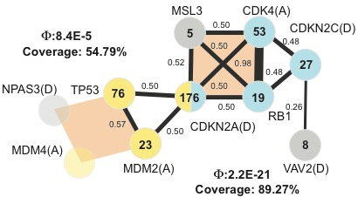
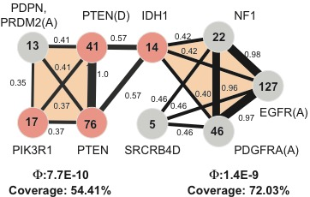
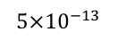
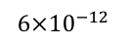
CoMEt results on TCGA Glioblastoma (GBM)
398 mutated genes in 261 tumor samples [TCGA, Nature 2008]
Exclusive modules
Figure 5 [TCGA, Nature 2008]
Different variants of CDKN2A are in Rb and p53 signaling
Rb signaling
$$5×{10}^{−13}$$
$$6×{10}^{−12}$$
Co-occurence
p53 signaling
gene-gene
module
Rb signaling
p53 signaling
PI(3)K signaling

Slide 15
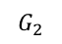
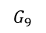
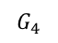
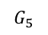
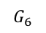
CoMEt analysis of subtype-specific mutations
Breast cancer expression subtypes (Sørlie et al. 2003)
HER2-enriched
ERBB2
Luminal B
(TCGA 2012)
Basal
TP53
Normal-like
Luminal A
PIK3CA
Simultaneous analysis of exclusive and subtype-specific alterations
Patients
Predefined subtypes
$$G_{4}$$
$$G_{5}$$
$$G_{6}$$
Subtype
Genes
CoMEt
$$G_{2}$$
Subtype
$$G_{9}$$
Subtype
Subtype
exclusive
co-occurring

Slide 16
CoMEt results on TCGA breast cancer (BRCA)
375 mutated genes and 4 subtypes in 507 tumor samples [TCGA, Nature 2012]
RTK/Ras signaling
p53 signaling
PI(3)K signaling
subtype
CoMEt simultaneously uncovers mutually exclusive and subtype-specific alterations.

Slide 17


Acknowledgements
Research Group
Benjamin J. Raphael (advisor)
Fabio Vandin
Hsin-Ta Wu
Mohammed El-Kebir
Dora Erdos
Matthew Reyna
Ashley Conard
Cyrus Cousins
Rebecca Elyanow
Gryte Satas
Funding & Data
CoMEt
Software (R and Python packages) https://github.com/raphael-group/comet
Interactive results http://compbio-research.cs.brown.edu/comet

